Slide 1
Data Day!
UIUC ECON 490: Applied Machine Learning in Economics

Slide 2
Why Use Data?
Qualitative vs. Quantitative

Slide 3
Brief History of Economic Thought
Adam Smith (1723 – 1790)
Anti-mercantilist, division of labor & the invisible hand
David Ricardo (1772 – 1823)
Specialization and (free) international trade
Alfred Marshall (1842 – 1924)
Brought mathematics to economics in early 1900s (Galileo in Physics, early 1600s)
S&D curves, marginal utility, marginal cost
John Maynard Keynes (1883 – 1946)
Business cycles, fiscal & monetary policy, unemployment
Milton Friedman (1912 – 2006)
Laissez-faire – free markets

Slide 4
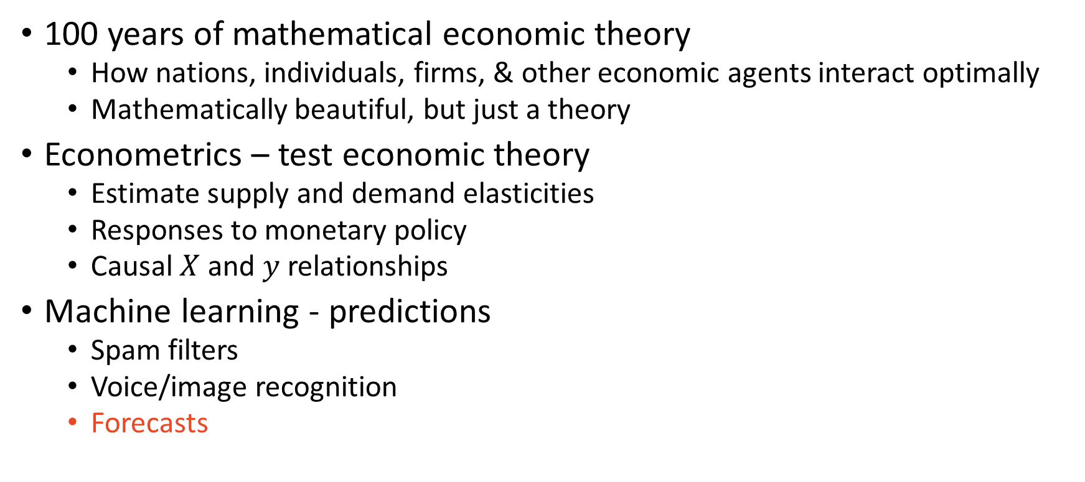
So Why Data?
100 years of mathematical economic theory
How nations, individuals, firms, & other economic agents interact optimally
Mathematically beautiful, but just a theory
Econometrics – test economic theory
Estimate supply and demand elasticities
Responses to monetary policy
Causal $X$ and $y$ relationships
Machine learning - predictions
Spam filters
Voice/image recognition
Forecasts

Slide 5
Economic Machine Learning Problems
Supervised – labelled
Predict sales next quarter
Predict customer satisfaction on a new product launch
Predict credit card fraud
Unsupervised – unlabeled
Identify groups of customers based upon spending habits
Identify expenditure patterns over the business cycle
Identify occupation groupings from skills
Need features to answer these questions
Can be expensive to obtain (proprietary data, experiments, etc.)

Slide 6
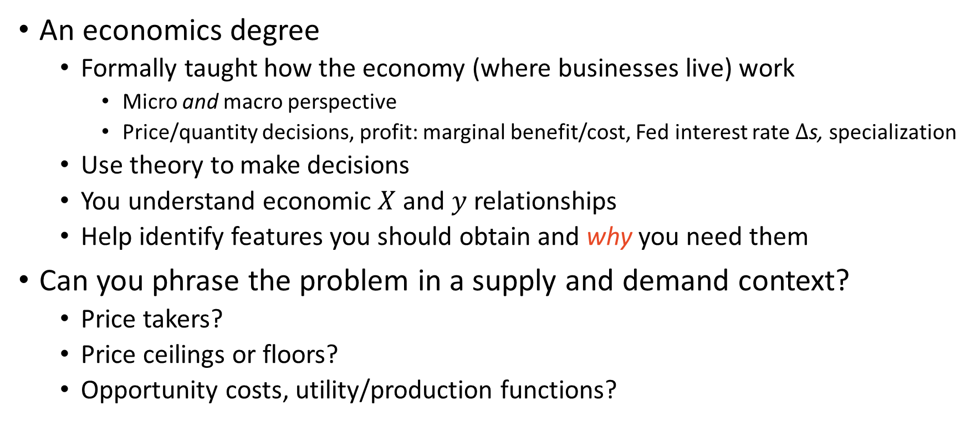
What you bring to the table
An economics degree
Formally taught how the economy (where businesses live) work
Micro and macro perspective
Price/quantity decisions, profit: marginal benefit/cost, Fed interest rate $Δ$s, specialization
Use theory to make decisions
You understand economic $X$ and $y$ relationships
Help identify features you should obtain and why you need them
Can you phrase the problem in a supply and demand context?
Price takers?
Price ceilings or floors?
Opportunity costs, utility/production functions?

Slide 7
Thinking About Problems with Economics
What do you care about: supply, demand, or equilibrium?
Supply:
What are the inputs, complements, substitutes, and/or investments
Ex) Image = f(pixels); pixels = g(color)
Label = image, features = pixels
Demand:
Income, alternative options, preferences
Ex) predicting customer product satisfaction: rating = u(customer, product)
Label = rating, features = customer characteristics, product characteristic
Equilibrium – the majority of situations
Require both supply and demand characteristics

Slide 8
Equilibrium Examples
Predicting census tract house prices
Producers: Housing construction
Consumers: homeowners
S: ability to build new houses - population density, new building permits
D: desire to live in the area - weather, employment
E: migration flows (driven by: jobs shortage or natural disaster)
Predicting credit card fraud
Producers: creditors
Consumers: creditees
S: Competitors interest rate, federal funds rate
D: Income, MPC/MPS, assets/liabilities, economic conditions faced by creditee
E: credit interest rates

Slide 9
Question – What determine prices?
Are wages an outcome from:
Demand
Equilibrium
Supply

Slide 10
Answer
P
S
P*
D
Q*
Q

Slide 11

Data for Machine Learning
Goal: predict a label
Tool: features
Req. features strongly correlated with label
For different reasons (along different dimensions)
Ex) Predict hotdog sales
Summer, upcoming holiday, temperature, rain forecast
All environmental variables
Can we do better?
Complements/substitutes: price of hotdog buns, price of hamburgers, GrubHub fee
Regional: city/suburban/rural, business cycle, median income, local population
More (quality) observations produce higher quality predictions
Garbage in, garbage out
Predict hotdog sales using windspeeds of Jupiter

Slide 12
Data for Machine Learning
Machine learning is data hungry
Depends on algorithm
Algorithms based upon minimum data size requirements for efficacy
Small
OLS
KNN
Naïve Bayes
Medium
Logit
Support vector machines
Random Forest
Large
Neural networks – I will find you and I will correlate you. But only with oodles of data

Slide 13
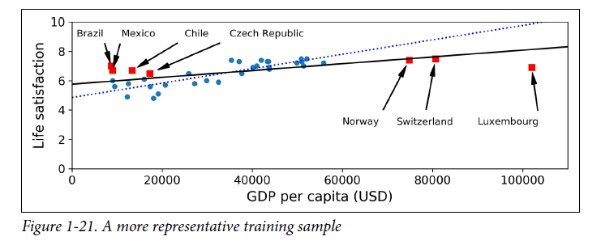
Data for Machine Learning
Conceptual data requirement: representative sample splits
Start with whole data
Split data into a train set and a test set
Split train set into validation sets

Slide 14
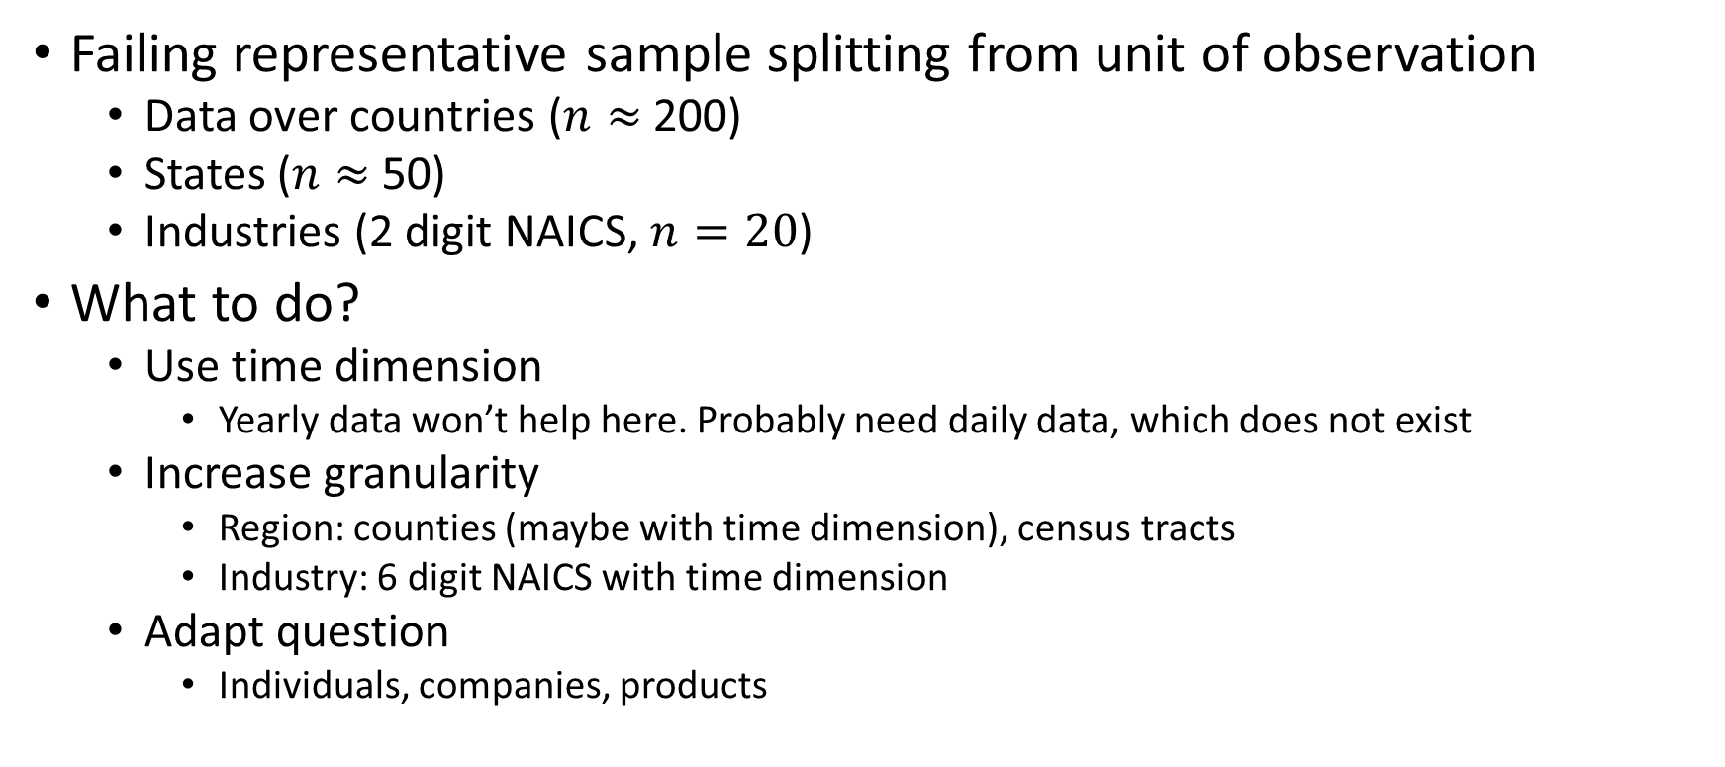
Troublesome Data for Machine Learning
Failing representative sample splitting from unit of observation
Data over countries ($n≈$200)
States ($n≈$50)
Industries (2 digit NAICS, $n=20$)
What to do?
Use time dimension
Yearly data won’t help here. Probably need daily data, which does not exist
Increase granularity
Region: counties (maybe with time dimension), census tracts
Industry: 6 digit NAICS with time dimension
Adapt question
Individuals, companies, products

Slide 15


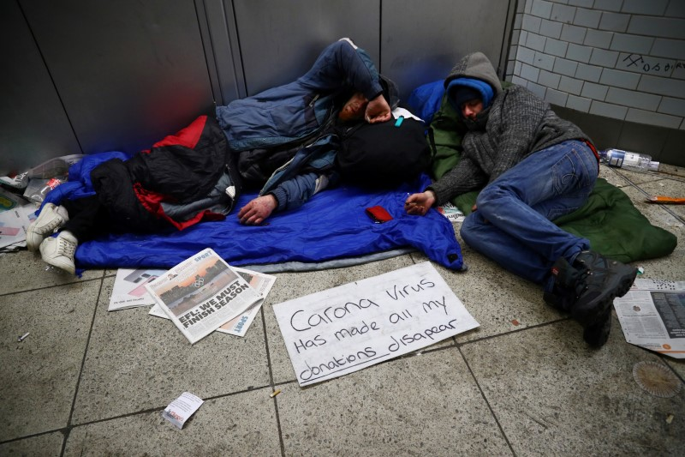
Question – Unit of Observation
Because of COVID-19, I want to predict the annual state-level unemployment growth rates from 2019 to 2020. My dataset covers 53,287 individuals.
How many observations do I have?

Slide 16
Answer
50

Slide 17
The Nitty Gritty
What makes data, data?

Slide 18
Data Structures and Format
Structures
Cross-section
Observations: “individuals”
i.e. regions, people, companies, etc.
Panel
Observations: individuals and time
Ex) monthly state unemployment rates
Time series
Observations: time
Ex) interest rates, exchange rates
How to tell: Would it make sense for me to have lagged label as a feature?
Format
Every column is a feature
Every row is an observation

Slide 19
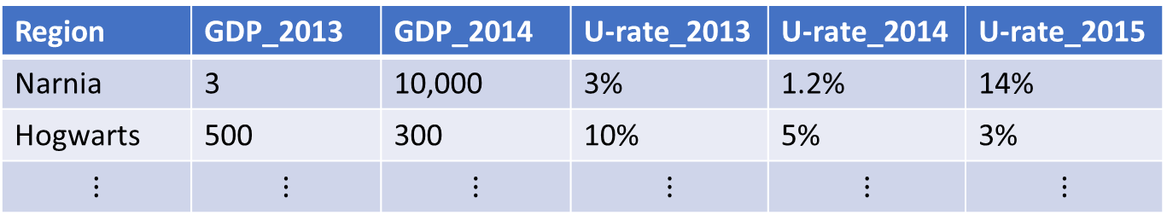
Question: Are these data properly formatted?
Region | GDP_2013 | GDP_2014 | U-rate_2013 | U-rate_2014 | U-rate_2015
Narnia | 3 | 10,000 | 3% | 1.2% | 14%
Hogwarts | 500 | 300 | 10% | 5% | 3%
$$⋮$$ | $$⋮$$ | $$⋮$$ | $$⋮$$ | $$⋮$$ | $$⋮$$

Slide 20
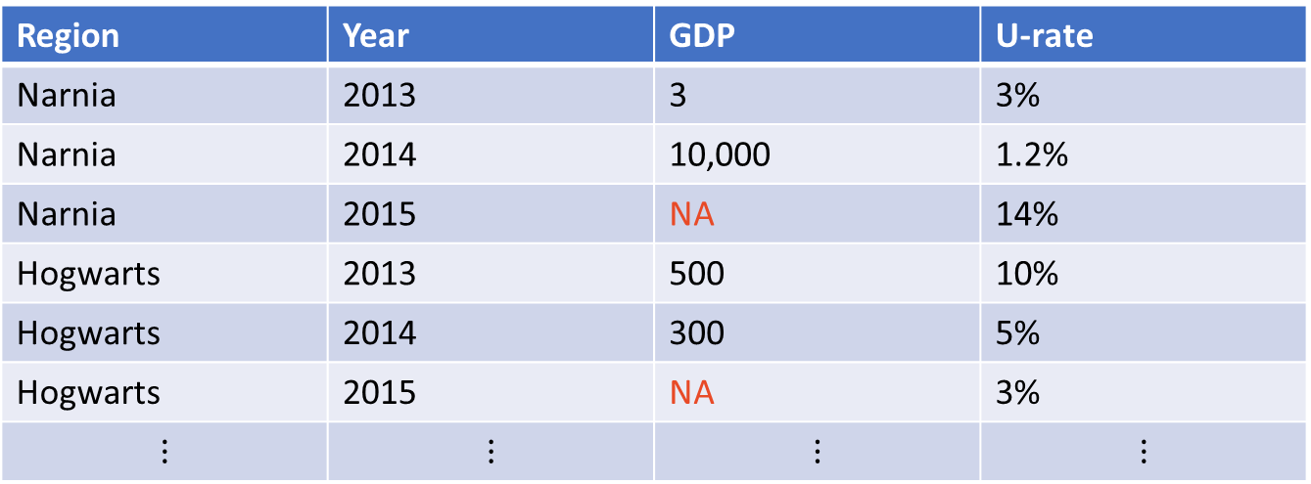
Answer
Region | Year | GDP | U-rate
Narnia | 2013 | 3 | 3%
Narnia | 2014 | 10,000 | 1.2%
Narnia | 2015 | NA | 14%
Hogwarts | 2013 | 500 | 10%
Hogwarts | 2014 | 300 | 5%
Hogwarts | 2015 | NA | 3%
$$⋮$$ | $$⋮$$ | $$⋮$$ | $$⋮$$

Slide 21
Pivoting
Pivoted from “wide” format to “long” format
Long format – properly formatted for analysis
Wide format – Manual inspection, maybe summary statistic/EDA
Application – Calculating skill mediods across job postings
Plotting a subset of data
If plotting a subset, why not input a subset of the data instead of pivoting?

Slide 22

Pivoting
WAIT ONE MINUTE!
What about the missing data?

Slide 23

Pivoting
Very astute budding machine learner!
Pivoting from wide to long or from long to wide will likely lead to missing values!

Slide 24
Pivoting
Well then what do you do with those missing values?

Slide 25
Pivoting
Well, dear astute machine learner…

Slide 26
Missing data
Fill the missing value
Forward fill (use “previous” values) or backward fill (use “future” values)
Global average or median
Within “group” average or median
Unit = individual, variable = wage, group = working in manufacturing
Interpolate the missing value (requires time dimension)
Linearly
Cubic spline
Drop the observations
My recommendation
Fabricating data and introducing noise (garbage in…)
Ultimately, your choice.
WHATEVER YOU DO, explicitly document your decision (otherwise suspicious)

Slide 27
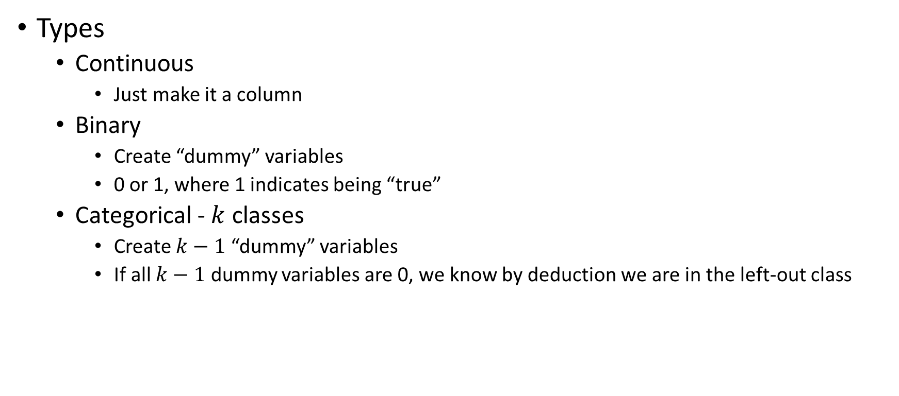
Variables and what to do with them
Types
Continuous
Just make it a column
Binary
Create “dummy” variables
0 or 1, where 1 indicates being “true”
Categorical - $k$ classes
Create $k−1$ “dummy” variables
If all $k−1$ dummy variables are 0, we know by deduction we are in the left-out class

Slide 28
Variables and what to do with them
But what about variables such as age?

Slide 29
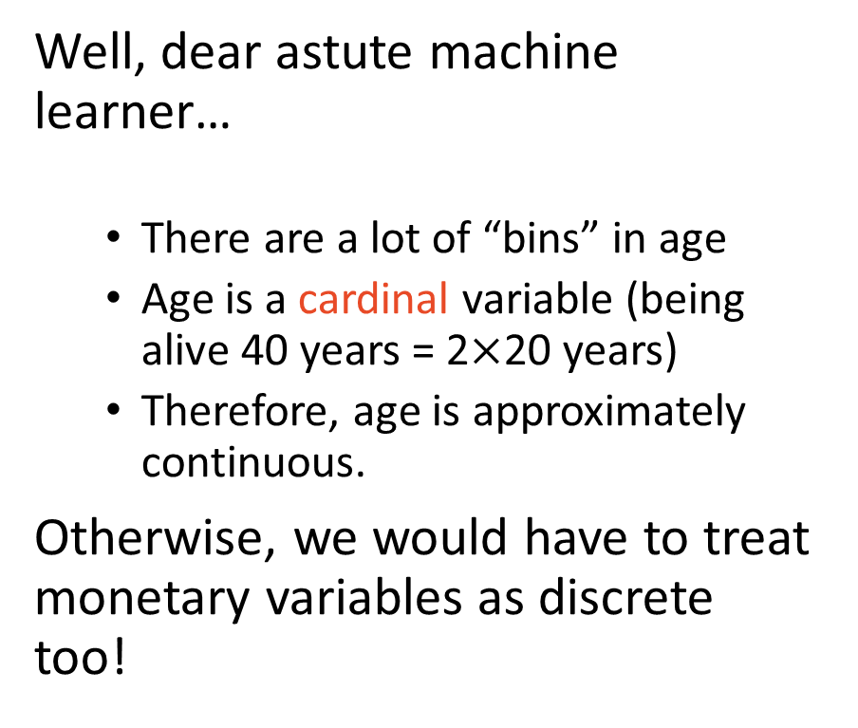
Variables and what to do with them
Well, dear astute machine learner…
There are a lot of “bins” in age
Age is a cardinal variable (being alive 40 years = 2$×$20 years)
Therefore, age is approximately continuous.
Otherwise, we would have to treat monetary variables as discrete too!

Slide 30
Variables and what to do with them
Types
Continuous
Just make it a column
Discrete
Create binary/indicator/dummy variables
Wage | Student
Pfft, what’s that? | Yes
Adulting is hard | No
#parttime! | Yes
Parents’ dime | Yes
Wage | Is_student | Not_student
Pfft, what’s that? | 1 | 0
Adulting is hard | 0 | 1
#parttime! | 1 | 0
Parents’ dime | 1 | 0

Slide 31
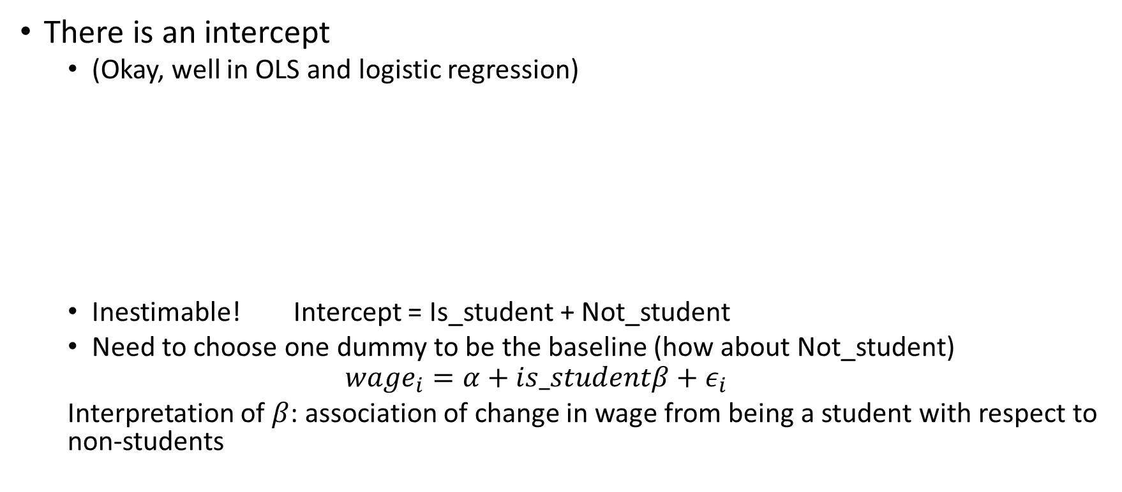
But in practice…
There is an intercept
(Okay, well in OLS and logistic regression)
Inestimable! Intercept = Is_student + Not_student
Need to choose one dummy to be the baseline (how about Not_student)
$$wage_{i}=α+is_studentβ+ε_{i}$$
Interpretation of $β$: association of change in wage from being a student with respect to non-students
Wage | Intercept | Is_student | Not_student
Pfft, what’s that? | 1 | 1 | 0
Adulting is hard | 1 | 0 | 1
#parttime! | 1 | 1 | 0
Parents’ dime | 1 | 1 | 0

Slide 32


Variables and what to do with them
Other models also only want one
If Is_student = 1, then you are a student
If Is_student = 0, then you are not
Discrete – multiple $(k)$classes
Produce $k−1$ dummy variables
Name | Organism
SpongeBob | Sponge
Squidward | Squid
Patrick | Starfish
Name | Squid | Starfish
SpongeBob | 0 | 0
Squidward | 1 | 0
Patrick | 0 | 1

Slide 33
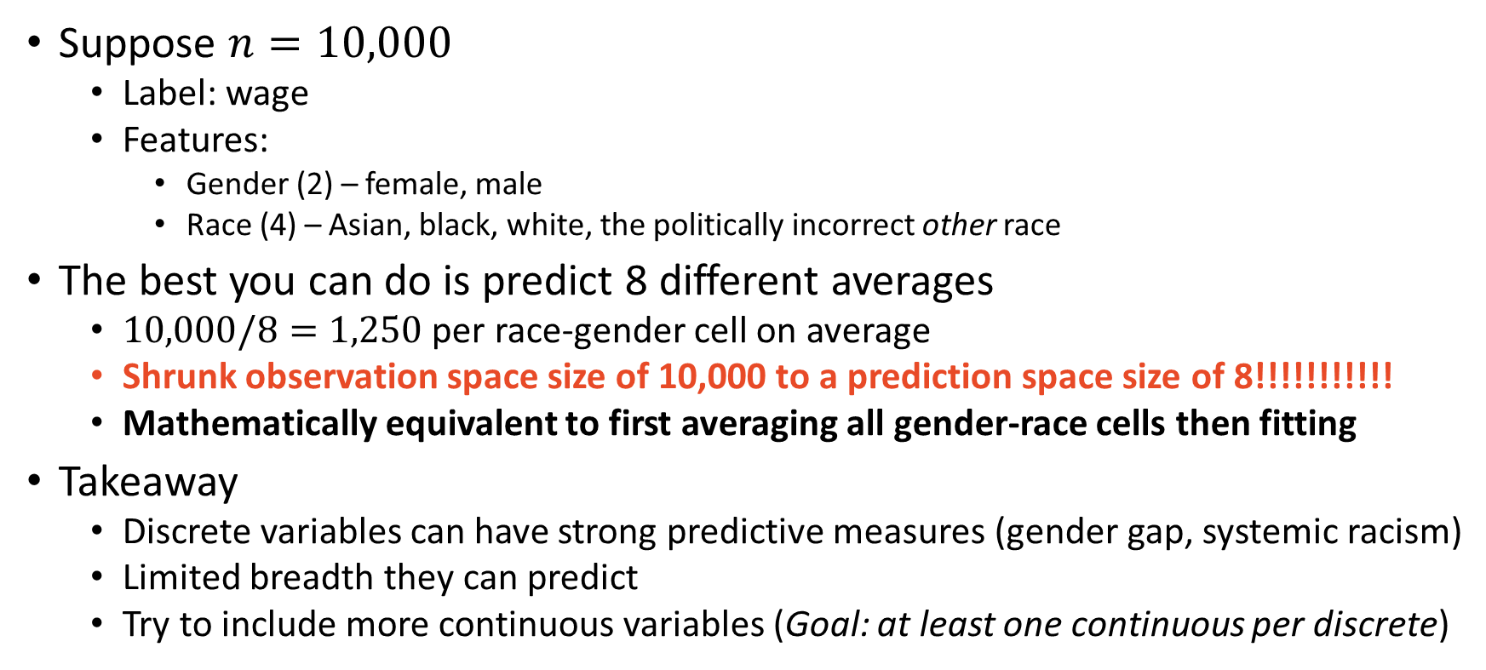
A Note on Discrete Variables
Suppose $n=10,000$
Label: wage
Features:
Gender (2) – female, male
Race (4) – Asian, black, white, the politically incorrect other race
The best you can do is predict 8 different averages
$10,000/8=1,250$ per race-gender cell on average
Shrunk observation space size of 10,000 to a prediction space size of 8!!!!!!!!!!!
Mathematically equivalent to first averaging all gender-race cells then fitting
Takeaway
Discrete variables can have strong predictive measures (gender gap, systemic racism)
Limited breadth they can predict
Try to include more continuous variables (Goal: at least one continuous per discrete)

Slide 34
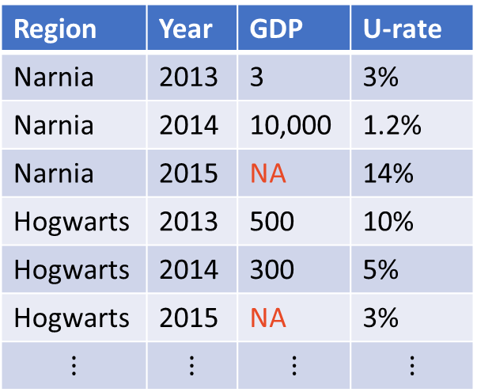
Fixed effects – Econometrics
Region | Year | GDP | U-rate
Narnia | 2013 | 3 | 3%
Narnia | 2014 | 10,000 | 1.2%
Narnia | 2015 | NA | 14%
Hogwarts | 2013 | 500 | 10%
Hogwarts | 2014 | 300 | 5%
Hogwarts | 2015 | NA | 3%
$$⋮$$ | $$⋮$$ | $$⋮$$ | $$⋮$$
Dummies for region/individuals and/or time
Caution!
Potential for introducing many bad variables
Garbage in…
Increase computational cost (time to fit model)
Maybe year dummies make sense
Probably not region
See ECON 474 for linear regression fixed-effect techniques

Slide 35
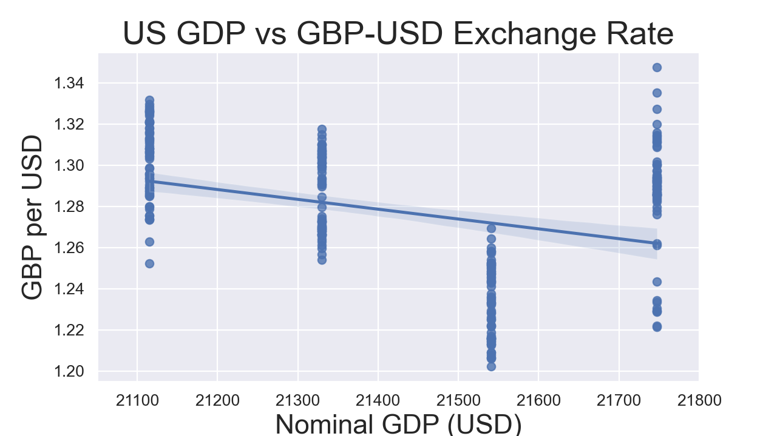
A Note on Granularity of Variables
Suppose
Label – daily exchange rate from January 1st to December 26th 2019
Feature – quarterly GDP
Even worse!
Same applies to regions
Label – Census tract level
Feature – state level
Want features to match label dimension as closely as possible!

Slide 36
Multiple Data Sets
Incredibly useful, especially when need more variables
I very rarely ever use just one data set
Joins (merging data together)
Each data set should have a key to locate where to merge
Examples
Current Population Survey: CPSIDP
Time
Federal Information Process Standards (FIPS) codes: states, counties, tracts
Illinois FIPS: 17, Champaign county FIPS: 019, full Champaign FIPS: 17019
Perhaps multiple: FIPS and time

Slide 37
Left Join
Name | Organism
SpongeBob | Sponge
Squidward | Squid
Patrick | Starfish
Name | Organism | House
SpongeBob | Sponge | Pineapple
Squidward | Squid | Easter Island Head
Patrick | Starfish | NA
A
Name | House
SpongeBob | Pineapple
Squidward | Easter Island Head
Mr. Krabs | Anchor
B

Slide 38
Right Join
Name | Organism
SpongeBob | Sponge
Squidward | Squid
Patrick | Starfish
Name | Organism | House
SpongeBob | Sponge | Pineapple
Squidward | Squid | Easter Island Head
Mr. Krabs | NA | Anchor
A
Name | House
SpongeBob | Pineapple
Squidward | Easter Island Head
Mr. Krabs | Anchor
B

Slide 39
Inner Join
Name | Organism
SpongeBob | Sponge
Squidward | Squid
Patrick | Starfish
Name | Organism | House
SpongeBob | Sponge | Pineapple
Squidward | Squid | Easter Island Head
A
Name | House
SpongeBob | Pineapple
Squidward | Easter Island Head
Mr. Krabs | Anchor
B

Slide 40
Outer Join
Name | Organism
SpongeBob | Sponge
Squidward | Squid
Patrick | Starfish
Name | Organism | House
SpongeBob | Sponge | Pineapple
Squidward | Squid | Easter Island Head
Patrick | Starfish | NA
Mr. Krabs | NA | Anchor
A
Name | House
SpongeBob | Pineapple
Squidward | Easter Island Head
Mr. Krabs | Anchor
B

Slide 41
Time Series
This is not a time series class
Your standard errors and coefficients will be wrong
Go take ECON 472
But machine learning doesn’t care about that
Create features that are lags of you label and proceed as normal
BE CAREFUL with missing dates

Slide 42
Yahoo GBP per USD Exchange Rate Data
Raw
Properly formatted with lag
Date | Close
2019-01-01 | 1.274
2019-01-02 | 1.275
2019-01-03 | 1.242
2019-01-04 | 1.262
2019-01-07 | 1.273
Date | Day | Close | Lag Close
2019-01-01 | Tuesday | 1.274 | 1.268
2019-01-02 | Wednesday | 1.275 | 1.274
2019-01-03 | Thursday | 1.242 | 1.275
2019-01-04 | Friday | 1.262 | 1.242
2019-01-05 | Saturday | NA | 1.262
2019-01-06 | Sunday | NA | NA
2019-01-07 | Monday | 1.273 | NA
One lag means cannot predict weekends AND Mondays
BUT! In this application the missing weekend observations should be ignored

Slide 43
For your project
Find a prediction problem:
on something you care about
with representative sample splitting,
at least 2,000 observations,
and at least 8 features.
Try to ensure at least 50% of features are continuous
Don’t limit yourself to one data source
Use your economics training to help you think of features
Ask me or TAs for help if you need it! Office hours are perfect for this!

Slide 44
For next time…
Skim read
PfDA Chapter 4: NumPy
PfDA Chapter 5 (and 6 and 7 and 8 and 10): Pandas
PfDA Chapter 10: Matplotlib
And Seaborn
Questions?

